Slide 1







STUDENT GRADE MANAGEMENT SYSTEM
PRESENTED BY GROUP 8

Slide 2





MEMBERS
Chhay Lyveng
LY Seavming
Chhoeun Kimchhun
Ly Bunleng

Slide 3

Introduction
Problem statement
Implementation
Code explanation
Result
Conclusion
OVERVIEW

Slide 4



INTRODUCTION
This is a Student Grade Management System. It helps manage student records by allowing users to add, view, edit, and delete student information and grades. It also calculates averages and shows student performance clearly and easily.

Slide 5


PROBLEM STATEMENT
Managing student grades manually can be time-consuming and prone to errors. Teachers or staff may find it hard to keep records organized, calculate averages, or update student data quickly. This program helps solve these issues with a simple and clear system.

Slide 6





IMPLEMENTATION
Using concept such as
loops
Functions
Double linked list
file IO (CSV)
standard library functions
structure
color coded
The following codes are written in code::block IDE

Slide 7
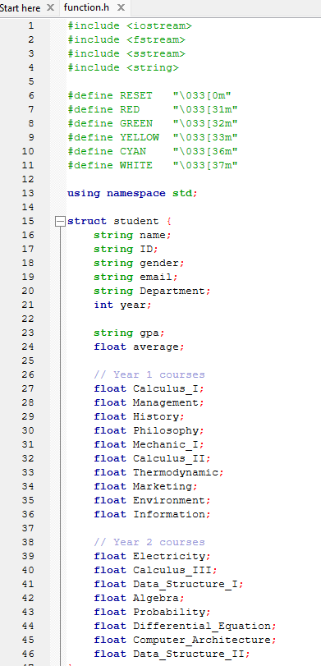
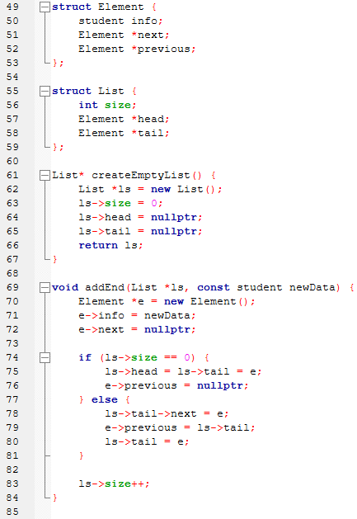
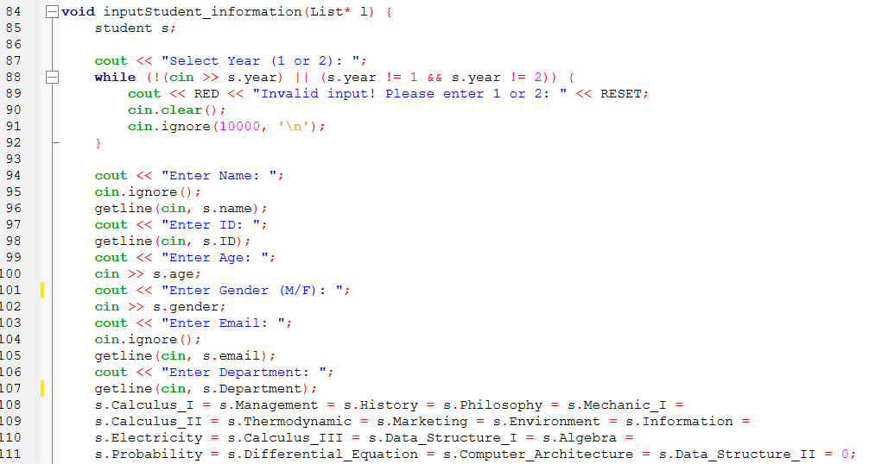
CODE Explaination
Struct
Void InputStudent_information

Slide 8
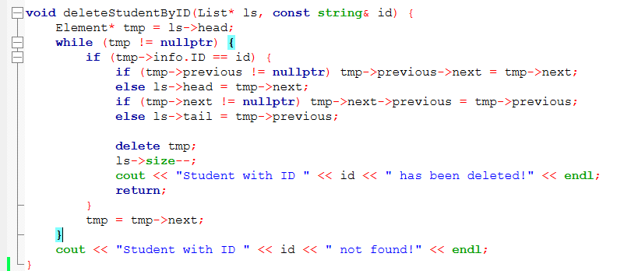
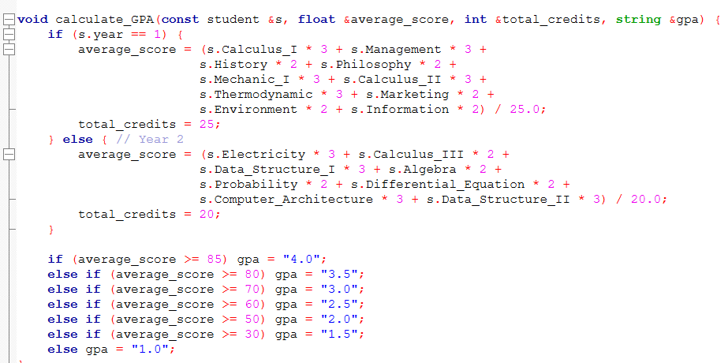
CODE Explaination
Void deleteStudentByID
Void calculate_GPA

Slide 9
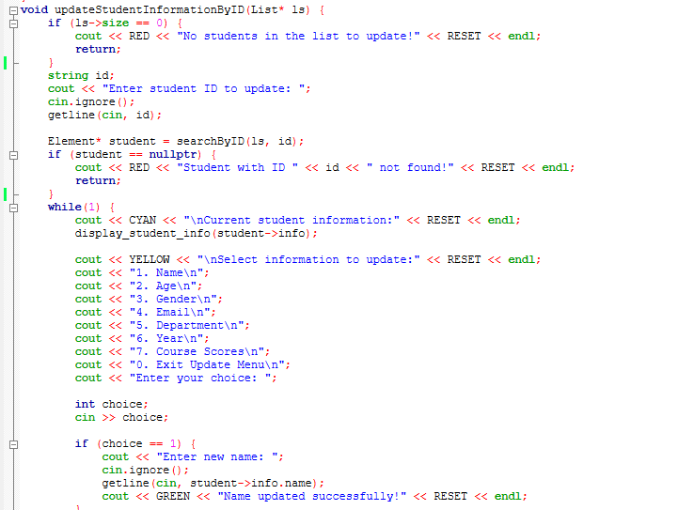
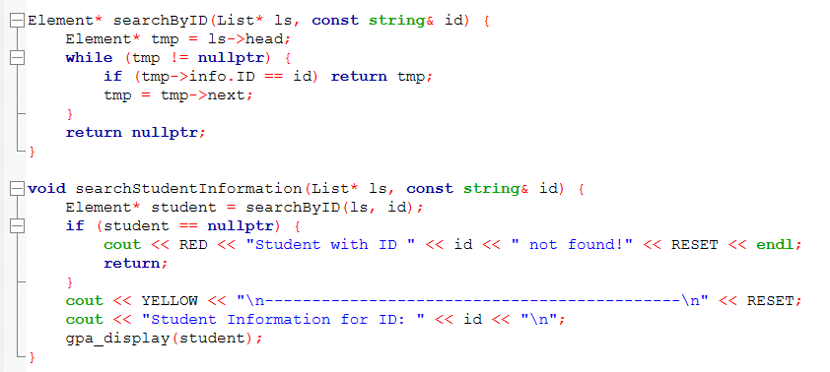
Void updateStudentInformation
Void searchStudentInformation

Slide 10
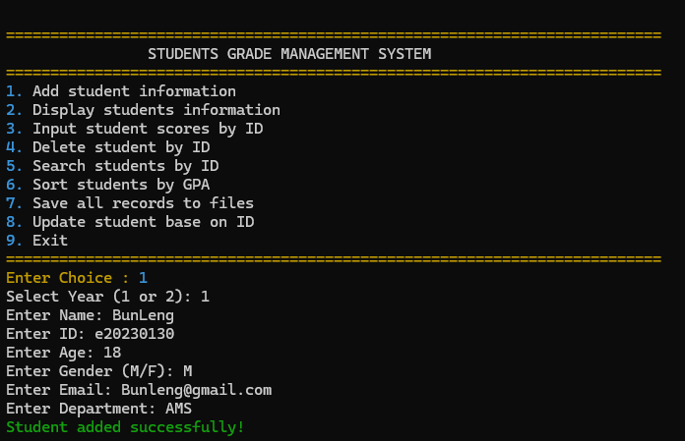
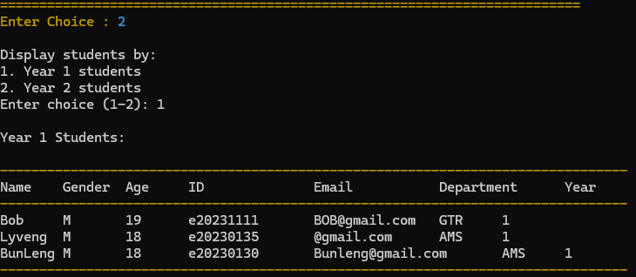
RESULT

Slide 11

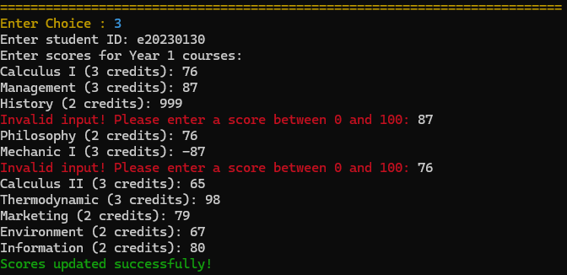
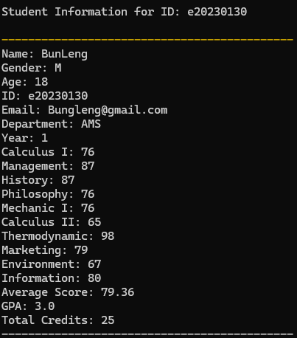
RESULT

Slide 12
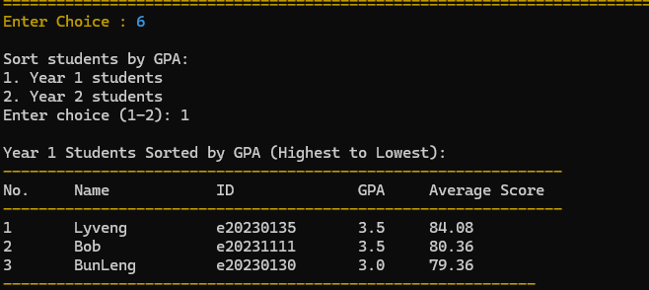

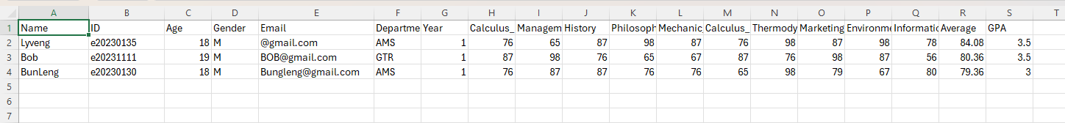
RESULT

Slide 13


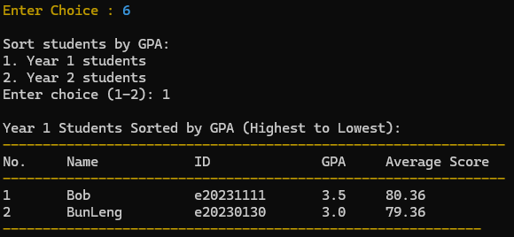
RESULT

Slide 14
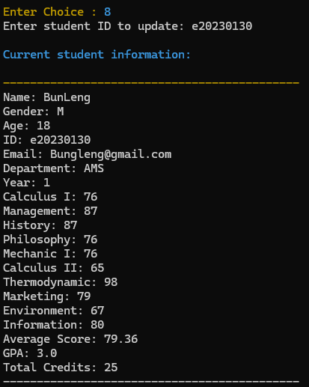
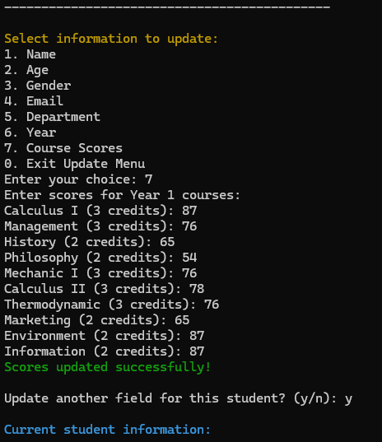
RESULT

Slide 15


CONCLUSION
In this project, We built a student management system with a doubly linked list that allows adding, deleting, updating scores, displaying by year, and sorting by GPA. It’s efficient, easy to use, and reliable for managing student data.

Slide 16
THANK
YOU
FOR YOUR ATTENTION

